Slide 1
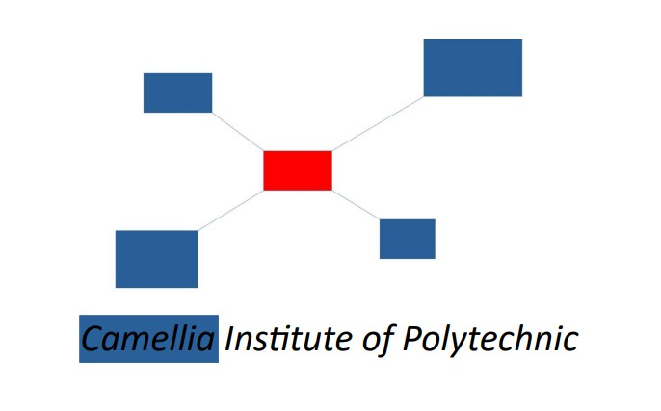
PDF TO AUDIO CONVERTER
CAMELLIA INSTITUTE OF POLYTECHNIC
PRESENTED BY
BISWANATH DEY(d202104118)
FARHAN CHOWDHURY(D202104120)
SOURAV MAHANTA (d202104128)
MD.RAKESH SK (d212220866)
GUIDED BY
Ms. ESHA DUTTA
Department: Computer science and engineering

Slide 2
Introduction:
PDF to the audio system is a screen reader application designed and constructed for an effective audio communication system
The PDF to Audio Converter project provides an alternative to access the PDF books for the blind, lazy, readers, and others

Slide 3
Using this PDF to Audio Converter the user will be able to listen to their favourite PDF file and can do their daily routine.

Slide 4
Topic of the project:
PDF to Audio converter using Python language.

Slide 5
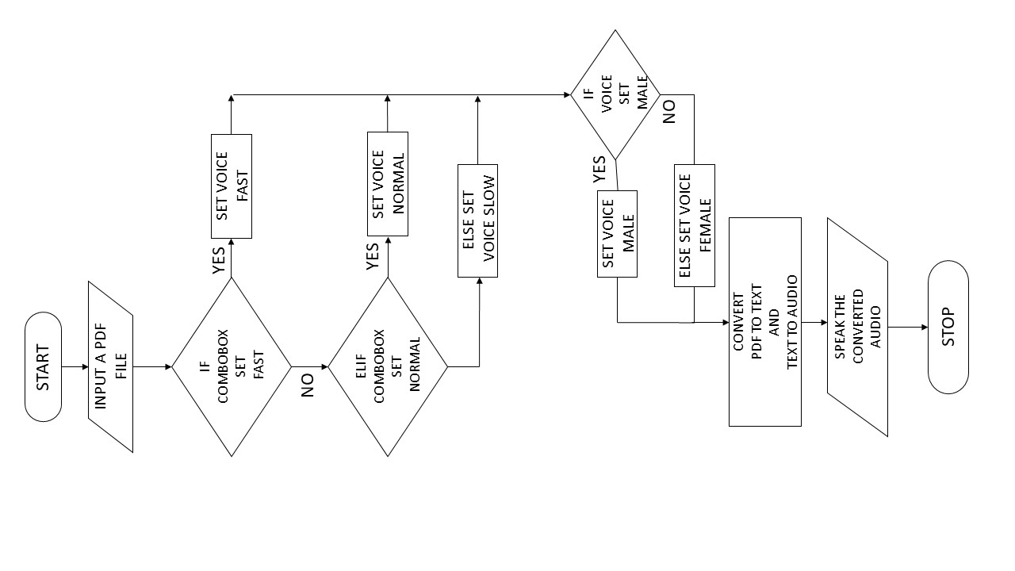
PROCESS DESCRIPTION

Slide 6
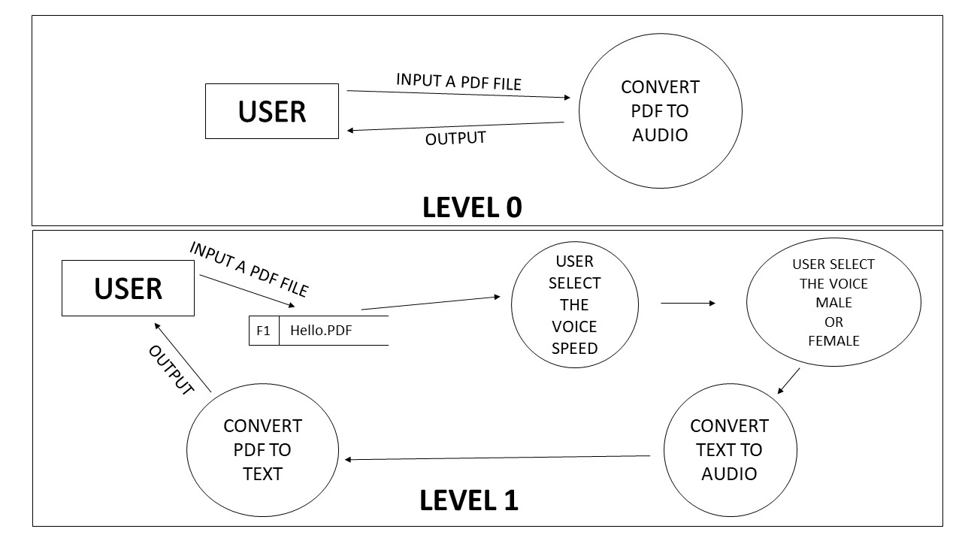

Slide 7
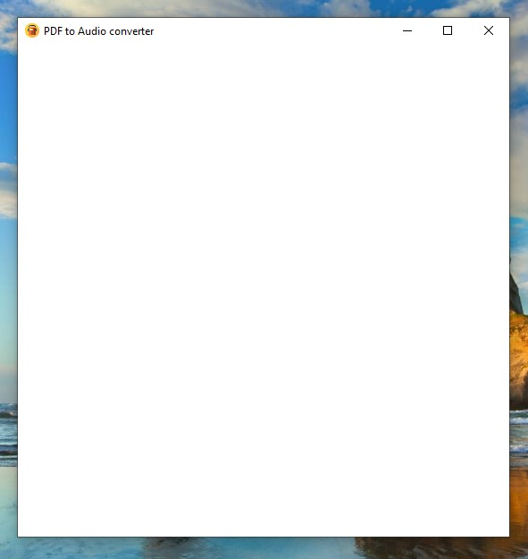
Then we stared the programming
part of the project.
At first we import all of module
that we used in this project.
like (tkinter, PIL, PyPDF2, pyttsx3)
Then We created a class named
audiobook.
Then we define the structure of the
Software like title, geometry,
background colour.

Slide 8
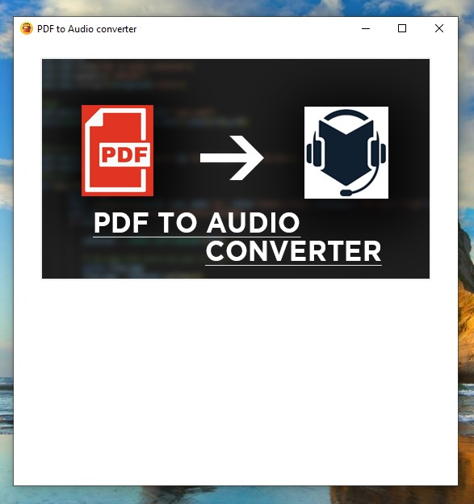
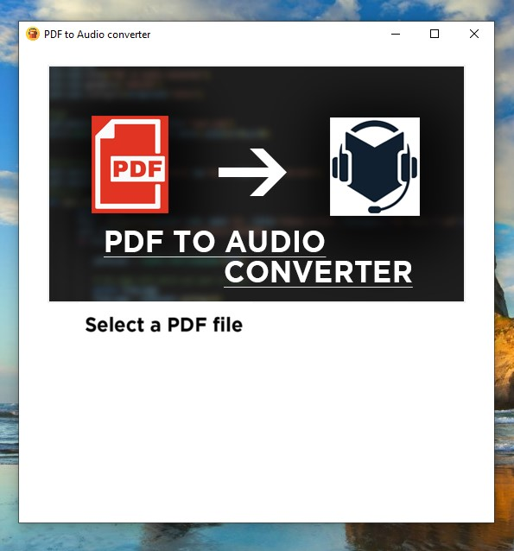
After that we import the interface picture
Then we created a label
(Select a PDF file)

Slide 9
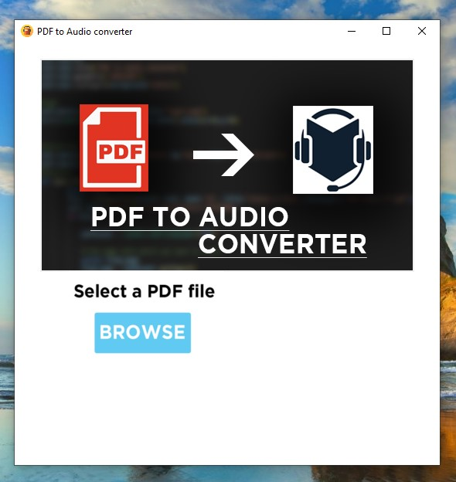
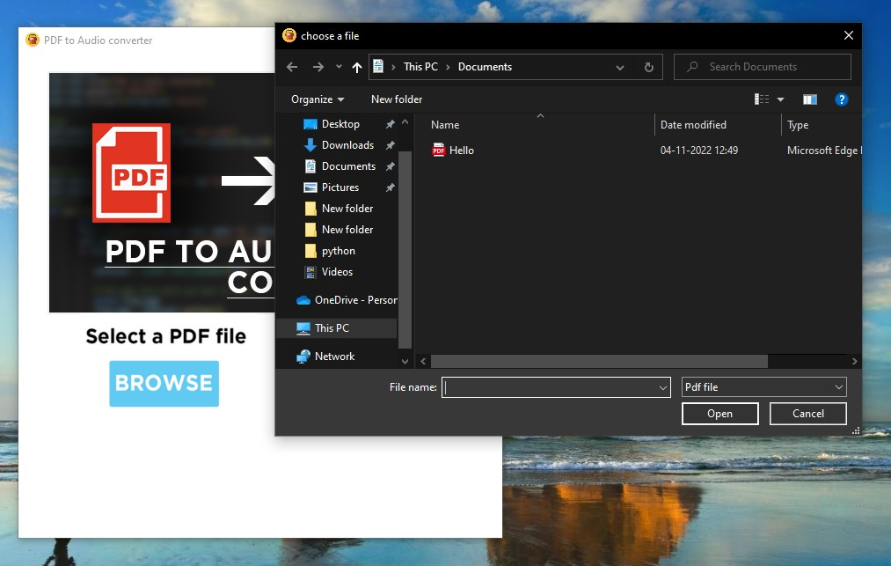
After that we created a button (Browse)
Then we write a method for the button to browse any PDF file from the computer.

Slide 10
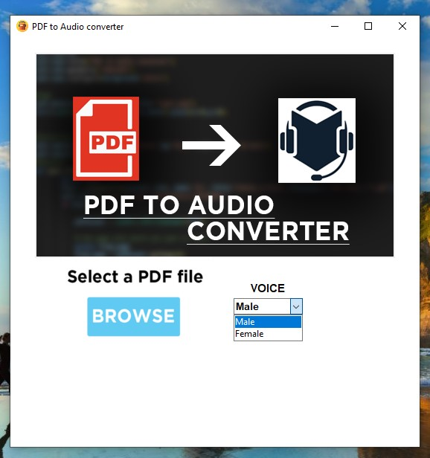
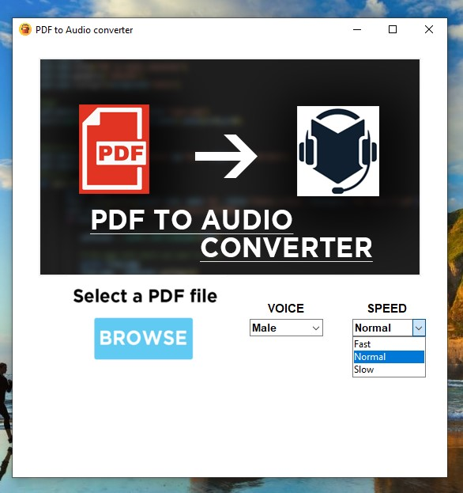
After that we create a dropdown box for changing the voice
Then we create another dropdown box for changing the speed of voice.

Slide 11
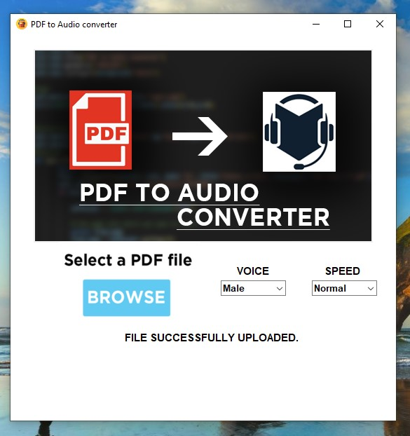
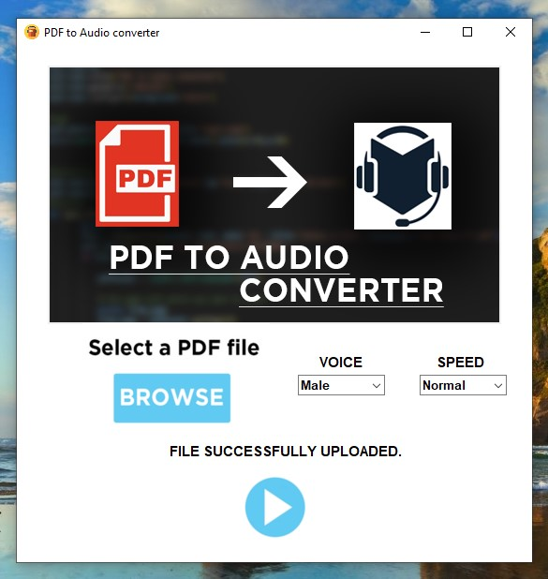
Then we write a method with PyPDF2 module that read the PDF file and extract the text from the PDF. Then we created another label (label 2) that show the user a message
After that we created another image that we also use like as a button(play) and write a method with pyttsx3 module that's helps to speak extracted text as an audio

Slide 12
Hardware used:
In this project, we used Dell Inspiron 15 3000 Laptop
Specification of the laptop:
RAM: 8 GB
STORAGE: 512 GB SSD
PROCESSOR: 11th Generation Intel® Core™ i5-1135G7

Slide 13
SOFTWARE USED:
OS: Windows 11 Home (Version 22H2)
PROGRAMMING LANGUAGE: Python (Version 3.10.6)
EDITOR: Visual Studio Code (Version 1.73.0)
PHOTO EDITOR: Adobe Photoshop cc (Version 14.0 x64)
DOCUMENTATION: Microsoft Word 2019
PPT: Microsoft Power Point 2019

Slide 14
FUTURE SCOPE:
In future we want to make some changes in the software like-
volume up/down.
proper play and pause button.
Audio saving button.

Slide 15
Support any type of file.
Browse from web.
convert into a mobile application.

Slide 16
BIBLIOGRAPHY:
Introduction to Computing & Problem Solving with Python.
Author: Dr. Jeeva Jose, Dr. P. Sojan Lal
Publication: Khanna publishing
Head-First Python, 2nd edition.
Author: Paul Barry
Publication: O’Reilly, 2016

Slide 17
REFERENCE:
https://www.geeksforgeeks.org/python-programming-language/
https://pypi.org/project/pip/
https://www.javatpoint.com/python-tutorial
https://www.w3schools.com/python/python_intro.asp

Slide 18
Conclusion:
It was found that this code works well for listening PDF text files.
This software helps those people who don't like to read books.
PDF to Audio converter will also help blind person to gain knowledge .

